Slide 1
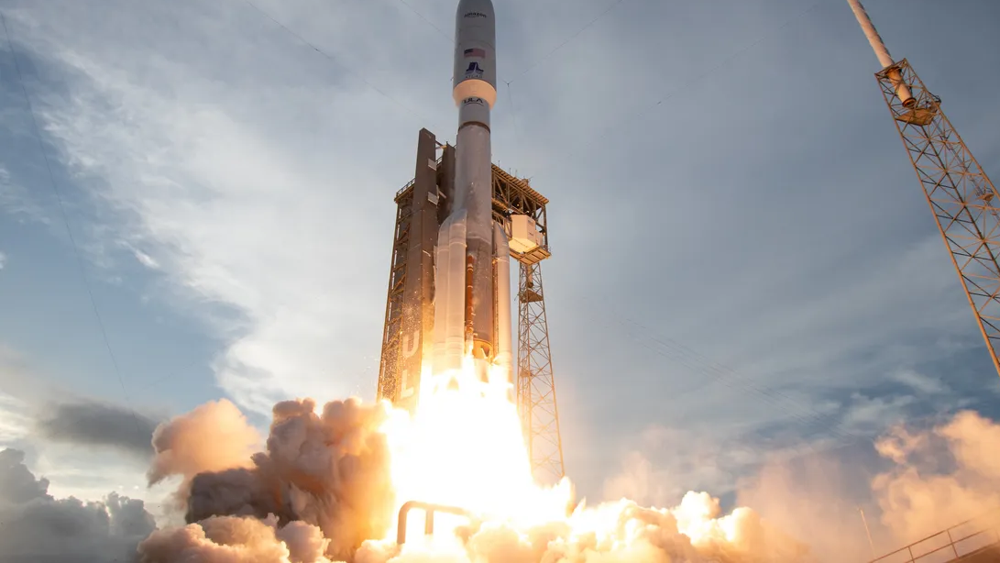
Applied Data science Capstone A study of Space race
Name: Wenhao chen
Date: jan 30th 2026

Slide 2
Outline
Executive Summary
Introduction
Methodology
Results
Conclusion

Slide 3

Executive Summary
Summary of Methodologies
1. Data Collection:
Accessed SpaceX launch data from Wikipedia and spacex.
2. Data Cleaning & Preparation:
Understand, clean, and preprocess the data.
Stored data in database and performed SQL queries.
Conducted exploratory data analysis.
Created new features and standardized the data.
3. Interactive Visualizations:
Built an interactive using Folium.
Built an interactive dashboard with Plotly Dash.
4. Model Building & Evaluation:
Implement multiple models.
Tuned hyperparameters with GridSearchCV.
Evaluated models using test data accuracy.

Slide 4
Introduction
Project Background and Context
This capstone project focuses on predicting the successful landing of the Falcon 9 first stage. SpaceX offers rocket launches at substantially lower costs than other providers, primarily because it can recover and reuse the first stage. By accurately predicting landing success, we can better estimate launch costs and generate valuable insights for companies competing with SpaceX in launch service bids.
Questions we focus on
What factors influwence the successful landing of the Falcon 9 first stage?
How accurately can machine learning models predict landing outcomes?
Which machine learning model performs best in predicting landing success?

Slide 5

Methodology
Data collection:
SpaceX Rest API
Web Scrapping
exploratory data analysis (EDA)
Pandas, numpy
SQL
Matplotlib, seaborn
interactive visual analytics
Folium
Plotly
classification models(scikit-learn)
Logistic Regression
SVM
Decision Trees,
KNN

Slide 6

Data Collection
Step 1:
Fetch data from spaceX
Step 2:
Web Scraping Wikipedia
Step 3:
Data Wrangling

Slide 7
Data Collection Step 1:
connect to theSpaceX API.
Endpoint: `https://api.spacexdata.com/v4/launches/past`
Parse API Response
Convert API response from JSON to a Python dictionary.
Extract relevant fields: launch date, launch site, payload mass, rocket type, outcome.
Store Data Locally
Convert data into Pandas DataFrame
Export to csv file.

Slide 8
Step 2 Scraping
Initiate Web Scraping
Target page `https://en.wikipedia.org/wiki/List_of_Falcon_9_and_Falcon_Heavy_launches`
Parse HTML Content
Use `BeautifulSoup` to parse the HTML content.
Extract the HTML table containing Falcon 9 launch records.
Converting data
Convert the extracted HTML table into a pandas DataFrame.
Clean and format the DataFrame, ensuring data consistency.
Export data to csv file

Slide 9
Data wrangling
Data Cleaning
Identify and fill missing values in the dataset.(mean value)
Explore the data
Identified column data types and categorized attributes as numerical or categorical.
Identify labels
Examined launch outcomes and converted them into a binary classification format (success or failure).
Identify Target
Visualized the number of launches per launch site to understand launch distribution.
Analyzed the distribution of orbit types within the dataset.
Explored launch outcomes and grouped them by binary result (successful vs. failed landings)
Standardized outcome labels to ensure consistency across the dataset.
Stored the processed launch outcome as the “Class” label.
Used the Class attribute as the target variable for training and evaluating machine learning models.

Slide 10

Predictive Analysis Methodology
1. Problem Definition
Define the objective as predicting the successful landing of the Falcon 9 first stage.
Formulate the task as a binary classification problem (success vs. failure).
2. EDA
3. Label & Target Definition
Convert landing outcomes into a binary Class label.
Define Class as the target variable for model training.
4. Model Selection
Split data into training and testing sets.
Train multiple machine learning models (e.g., Logistic Regression, Decision Tree, Random Forest, SVM).
Compare models to identify the best performer.
Apply cross-validation to reduce overfitting.
Tune hyperparameters for optimal performance.
9. Model Evaluation
Evaluate models using accuracy, precision, recall, F1-score, and confusion matrix.
Compare results across models.

Slide 11

Data Visualization
To gain insights into the importance of each variable, multiple visualizations were created to explore relationships between key features and launch outcomes:
Analyzed the relationship between Flight Number and Outcome to observe performance changes over successive launches.
Examined Flight Number and Launch Site to identify operational patterns across different launch locations.
Explored Payload Mass and Launch Site to assess how payload size varies by launch facility.
Investigated Orbit Type and Outcome to determine whether certain orbits are associated with higher landing success rates.
Visualized Flight Number and Orbit to study mission progression and orbit usage over time.
Analyzed Payload Mass and Orbit to understand how payload requirements differ across orbit types.
Evaluated the Yearly Success Rate to identify long-term trends in Falcon 9 landing performance.
Feature Engineering
Expanded categorical variables (such as launch site and orbit type) into dummy variables using one-hot encoding.
Prepared the dataset for machine learning models by transforming categorical features into numerical representations.
Data Preparation
Converted numerical columns to float64 data type to ensure compatibility with machine learning algorithms.
Verified data consistency and finalized the dataset for model training and evaluation.

Slide 12

SQL Queries Used
o Show each unique launch site
o Show 5 records where launch site names begin with 'CCA'
o Display the total payload mass carried by boosters launched by 'NASA (CRS)'
o Display average payload mass carried by booster version F9 v1.1
o List the date of the first successful ground landing outcome
o List the booster versions with successful outcomes landing on the drone ship with payloads between 4000kg and 6000kg.
o List the number of successful and failed mission outcomes
o List all of the booster versions that carried the max payload mass
o List the month name, outcome, booster version, and launch site for missions with failure outcomes landingon a drone ship in 2015.
o Show the distribution of outcomes between June 4th, 2010 and March 20th, 2017

Slide 13
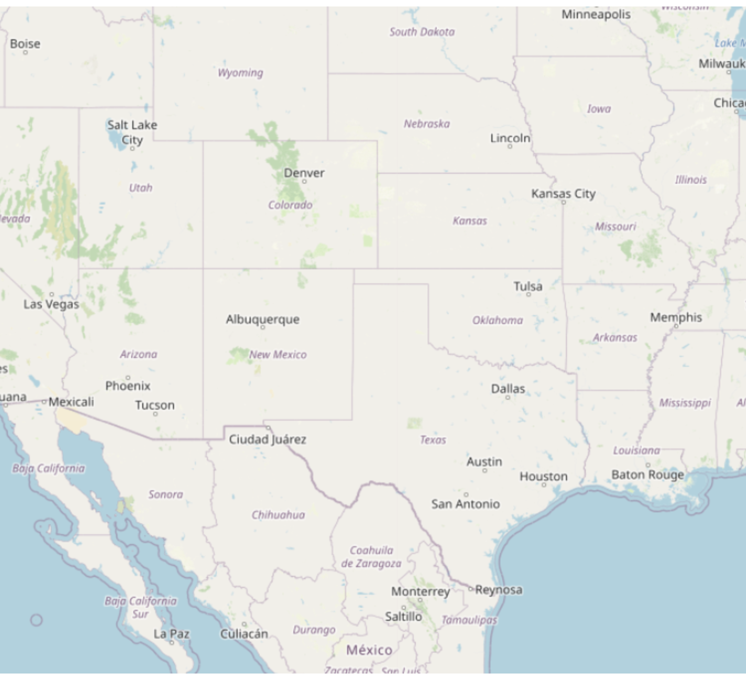
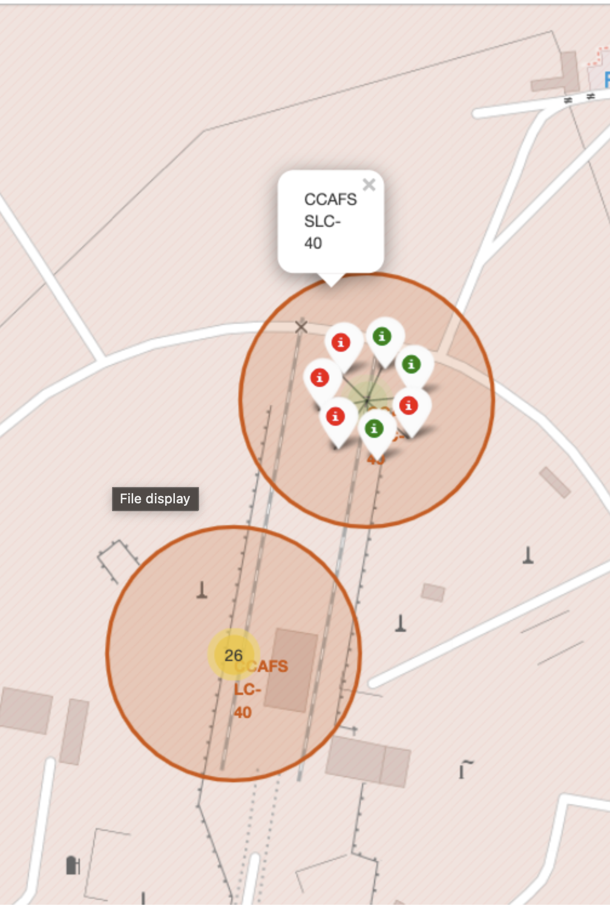
Interactive Map with Folium
Identified geographical patterns in the data by visualizing launch-related information on a map.
Marked all launch sites to provide an overview of their geographic distribution.
Displayed successful and failed launches to examine spatial differences in launch outcomes.
Visualized the distances between launch sites and nearby landmarks to explore potential geographical or operational influences.

Slide 14

Build a Dashboard with Plotly Dash
To enable interactive exploration of the data, a Plotly Dash dashboard was developed with the following components:
A Launch Site dropdown selector, which dynamically updates:
Pie Chart
When all sites are selected, the chart displays the distribution of successful launches across all launch sites.
When a specific launch site is selected, the chart shows the proportion of successful versus failed launches for that site.
Scatter Plot
When all sites are selected, the plot visualizes launch outcomes based on payload mass and booster version across all sites.
When a specific launch site is selected, the plot displays payload mass versus booster version outcomes for the selected site only.
A Payload Mass range slider that allows users to filter data points in the scatter plot, enabling focused analysis on specific payload ranges.

Slide 15
Predictive Analysis (Classification)
Load data
1
Apply StandardizedScaler on X
2
Convert Y to numpy array
3
Split training and testing data
4
Use GridSearchCV to test hyperparameters for multiple models:
5
Logistic Regression
SVC
Decision Tree Classifier
K Neighbors Classifier

Slide 16
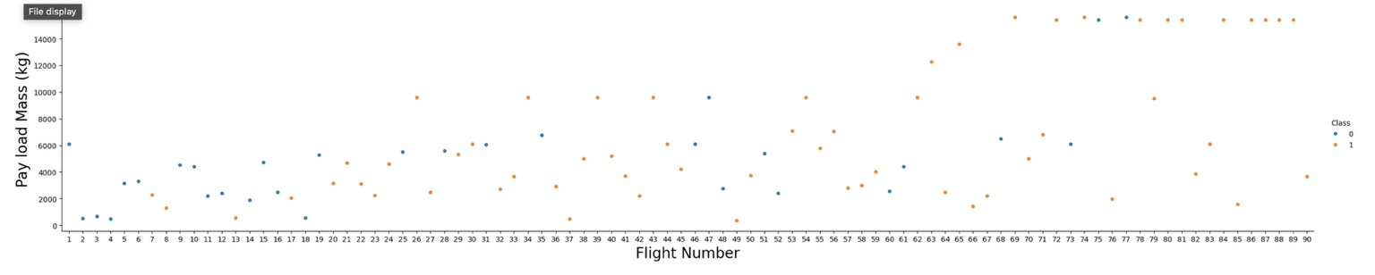
EDA result from Visualization Flight Number vs Pay load Mass
The scatter plot shows that landing success improves significantly as the flight number increases, indicating the impact of technological maturity and operational experience. While early launches exhibit a higher failure rate, later missions achieve higher success rates even with heavier payloads. This suggests that flight number is a strong predictor of landing success, whereas payload mass alone does not determine the outcome.

Slide 17
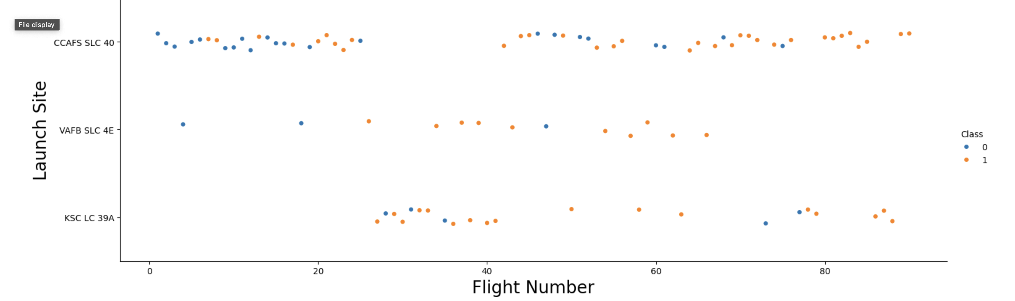
EDA result from Visualization Flight Number VS Launch Site
Mixed Outcomes at Major Launch Sites: Both CCAFS SLC 40 and KSC LC 39A exhibit a combination of successful and unsuccessful landings, suggesting that landing success is influenced by factors beyond the launch site alone.
Consistent Activity Across Flight Numbers: Launches at all sites occur across a wide range of flight numbers, indicating sustained operational activity over time without a clear site-specific trend in landing success.

Slide 18
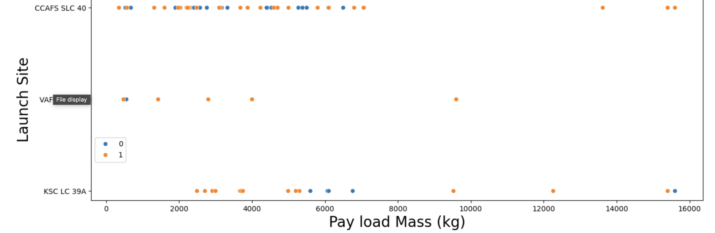
EDA result from Visualization Payload VS Launch Site
For every launch site the higher the payload mass, the higher the success
• Most of the launches with payload mass over 7000 kg were successful.
• KSC LC 39A has a 100% success rate for payload mass under 5500 kg too.

Slide 19
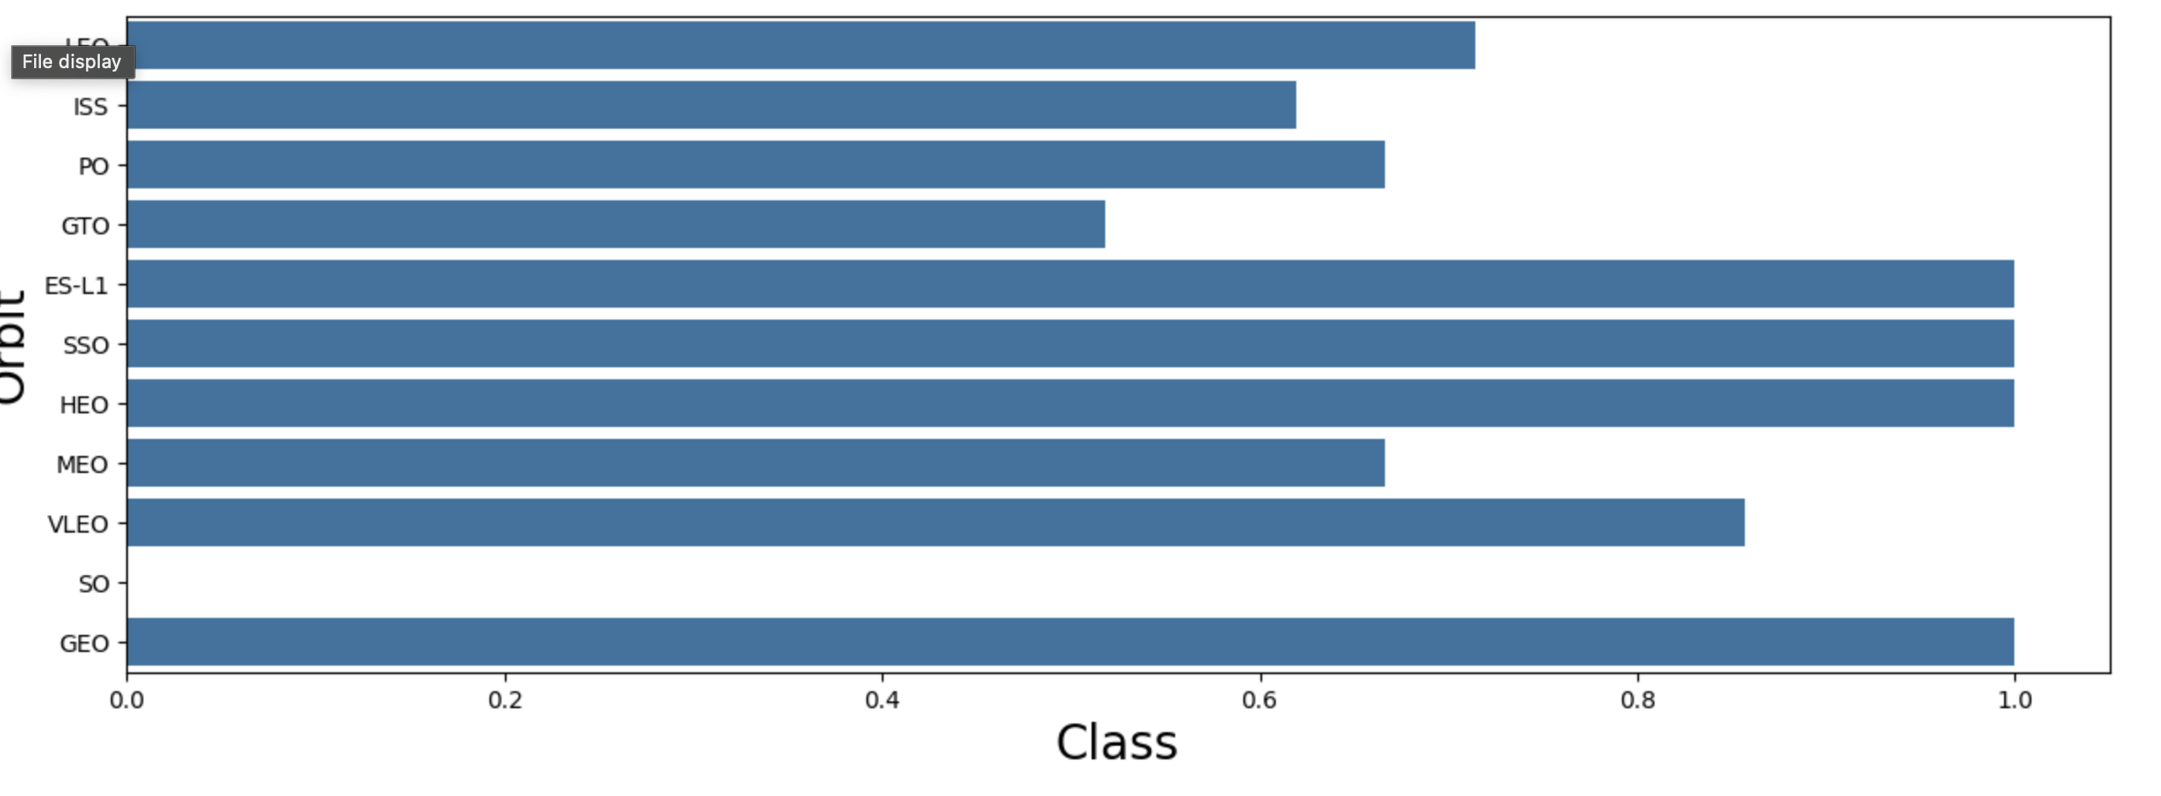
EDA result from Visualization success rate of each orbit type
Orbits with 100% success rate:
ES-L1, GEO, HEO, SSO
Orbits with 0% success rate:
SO
Orbits with success rate between 50% and 85%:
GTO, ISS, LEO, MEO, PO

Slide 20
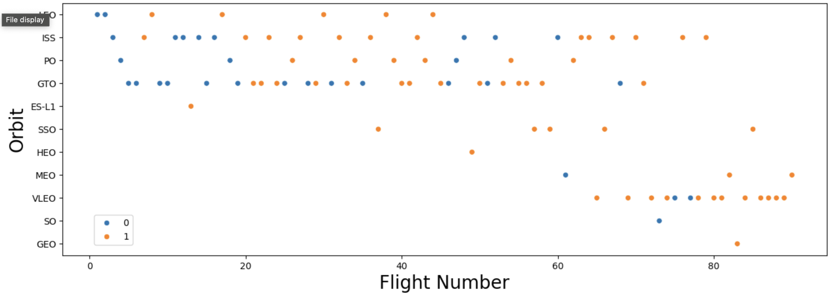
EDA result from Visualization FlightNumber and Orbit type
In the LEO orbit the Success appears related to the number of flights;
on the other hand, there seems to be no relationship between flight number when in GTO orbit.

Slide 21
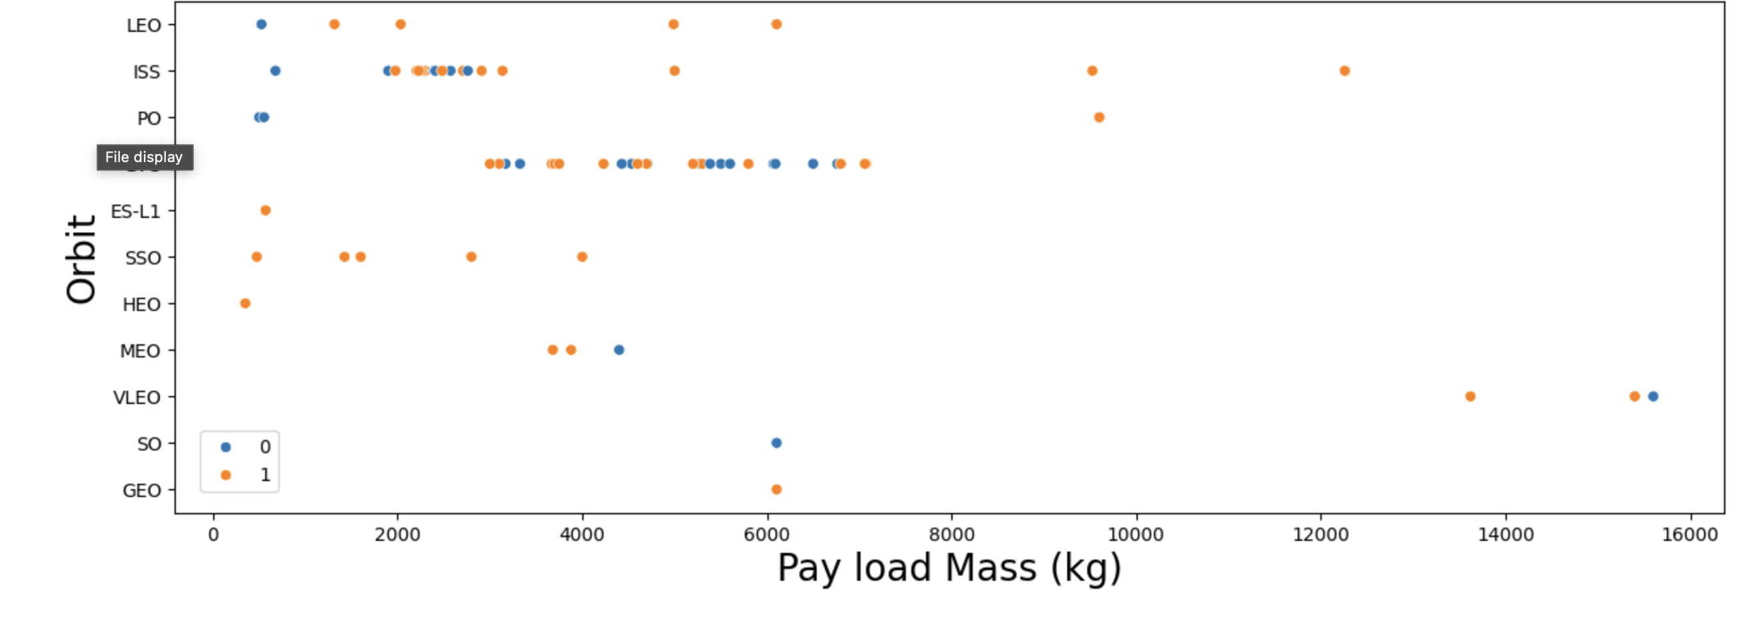
EDA result from Visualization Payload and Orbit type
Heavy payloads have a negative influence on GTO orbits and positive on GTO and Polar LEO (ISS) orbits.

Slide 22
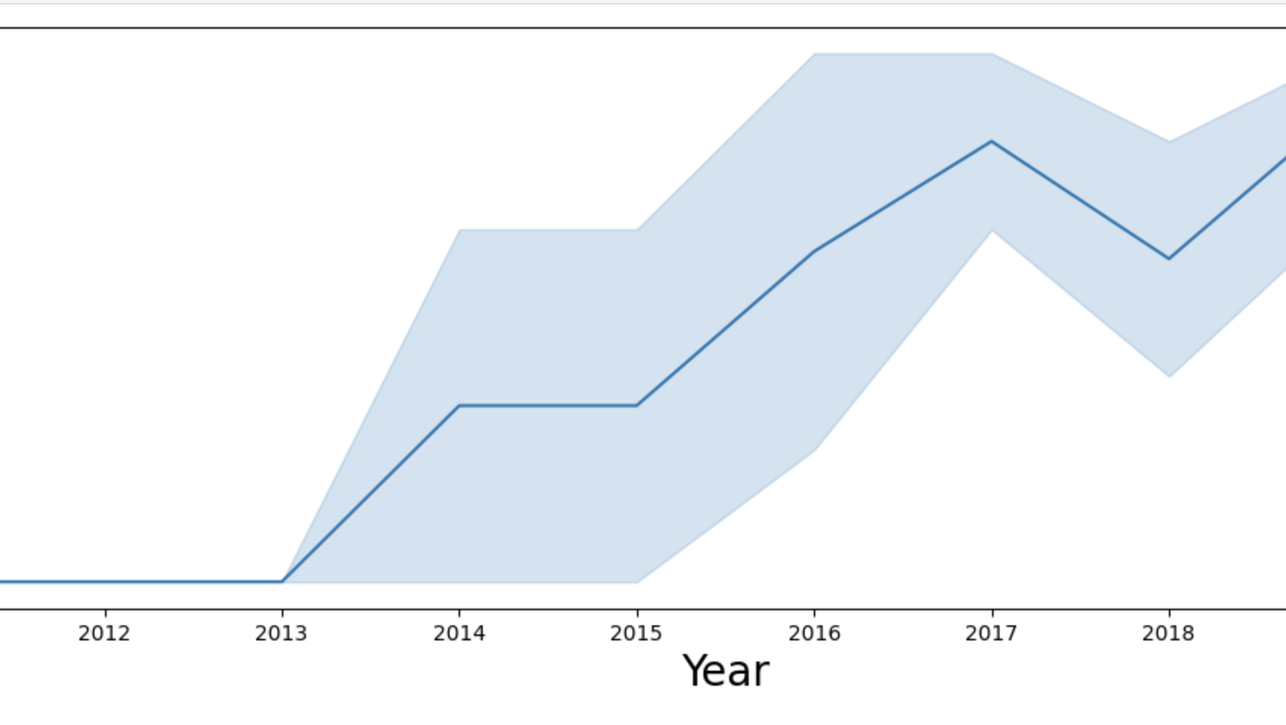
launch success yearly trend
The annual launch success rate has shown a significant improvement from 2013 onwards, reaching over 80% by 2020.
Despite a dip in 2018, the overall trend indicates increasing reliability and success in Falcon 9 launches over the years.

Slide 23
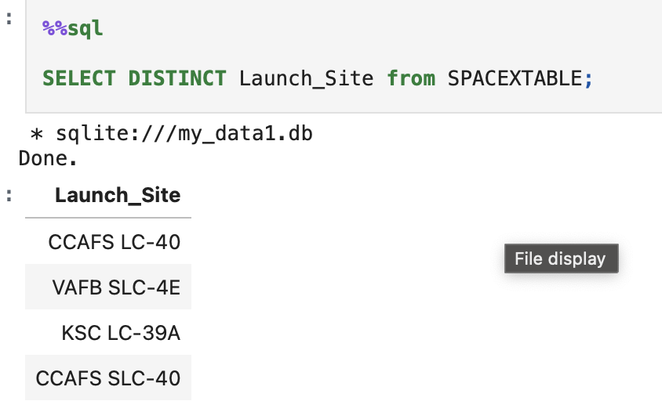
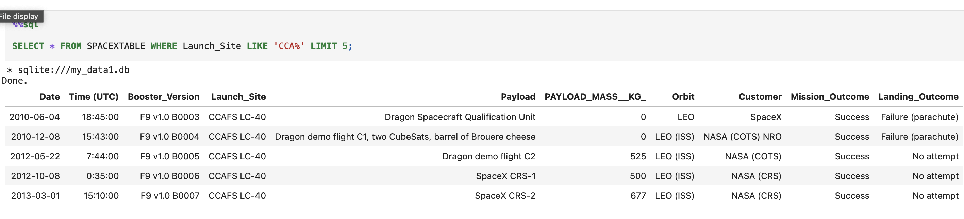
Sql result launch site relative task
1.There is 4 unique launch site.
2. we inquire 5 record from launch site name start with ‘CCA’

Slide 24

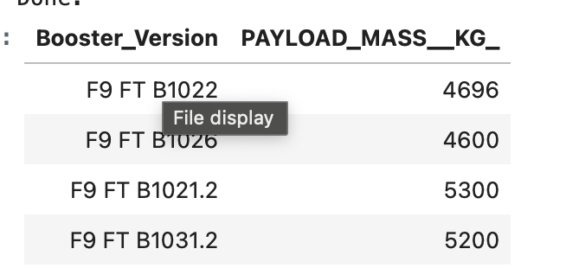
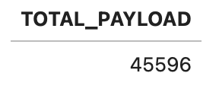
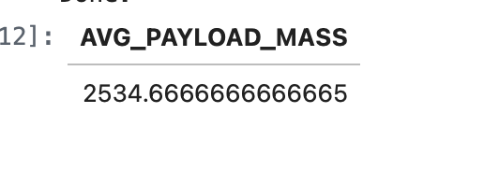
SqL pay load mass and data
Listing the date when the first successful landing outcome in ground pad was achieved.
Listing the names of the boosters which have success in drone ship and have payload mass greater than 4000 but less than 6000.
Displaying the total payload mass carried by boosters launched by NASA (CRS).
Displaying average payload mass carried by booster version F9 v1.1.

Slide 25
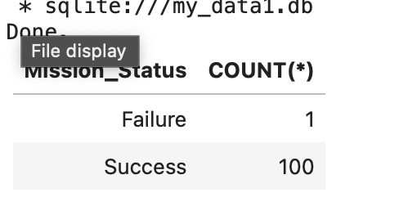
Sql total number of successful and failure mission outcomes

Slide 26
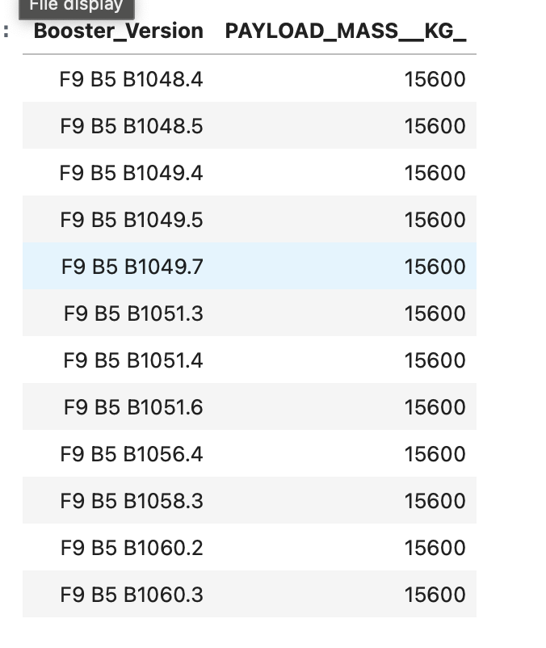
Sql names of the booster_versions which have carried the maximum payload mass.

Slide 27
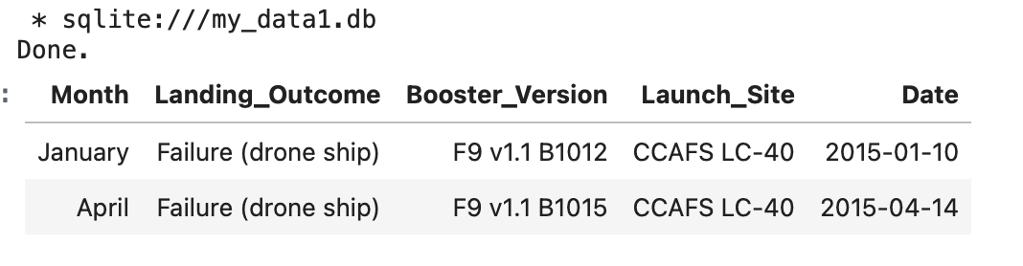
sql records which will display the month names, failure landing_outcomes in drone ship ,booster versions, launch_site for the months in year 2015

Slide 28
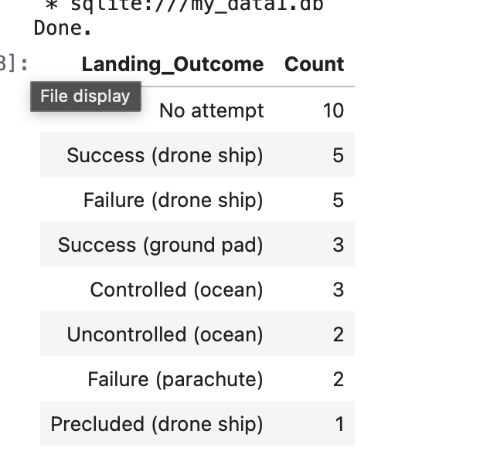
Sql Rank the count of landing outcomes (Failure or Success) between the date 2010-06-04 and 2017-03-20

Slide 29
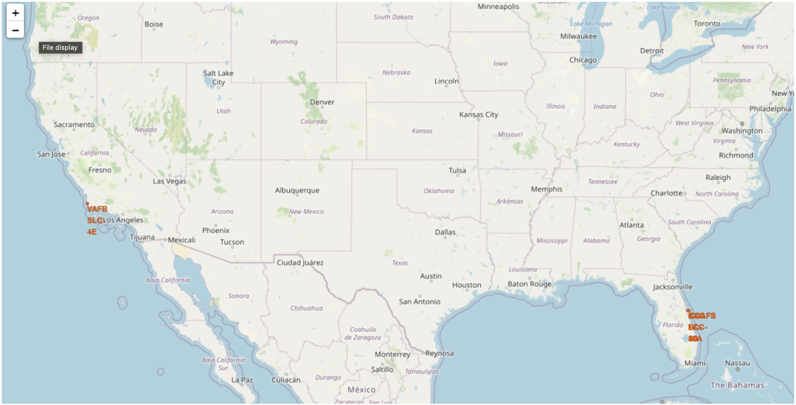
Interactive map with Folium All launch sites
1. Are all launch sites in proximity to the Equator?
Not all launch sites are located close to the Equator. While the Florida launch sites—Cape Canaveral Space Launch Complex 40 (CCAFS SLC-40) and Kennedy Space Center Launch Complex 39A (KSC LC-39A)—are relatively closer to the Equator, Vandenberg Air Force Base (VAFB SLC-4E) is situated at a much higher latitude of approximately 34.63° North.
2. Are all launch sites in very close proximity to the coast?
All identified launch sites are located near coastal regions. The Florida-based sites (CCAFS LC-40, CCAFS SLC-40, and KSC LC-39A) are positioned along the Atlantic coastline, while Vandenberg Air Force Base (VAFB SLC-4E) is located near the Pacific coast in California.

Slide 30
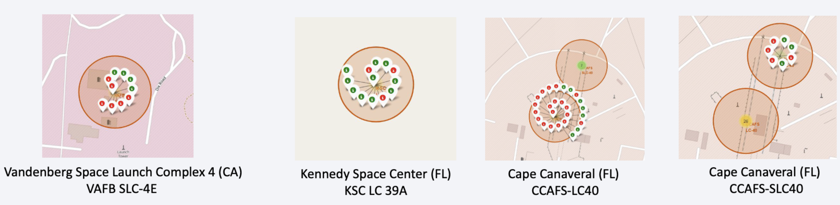
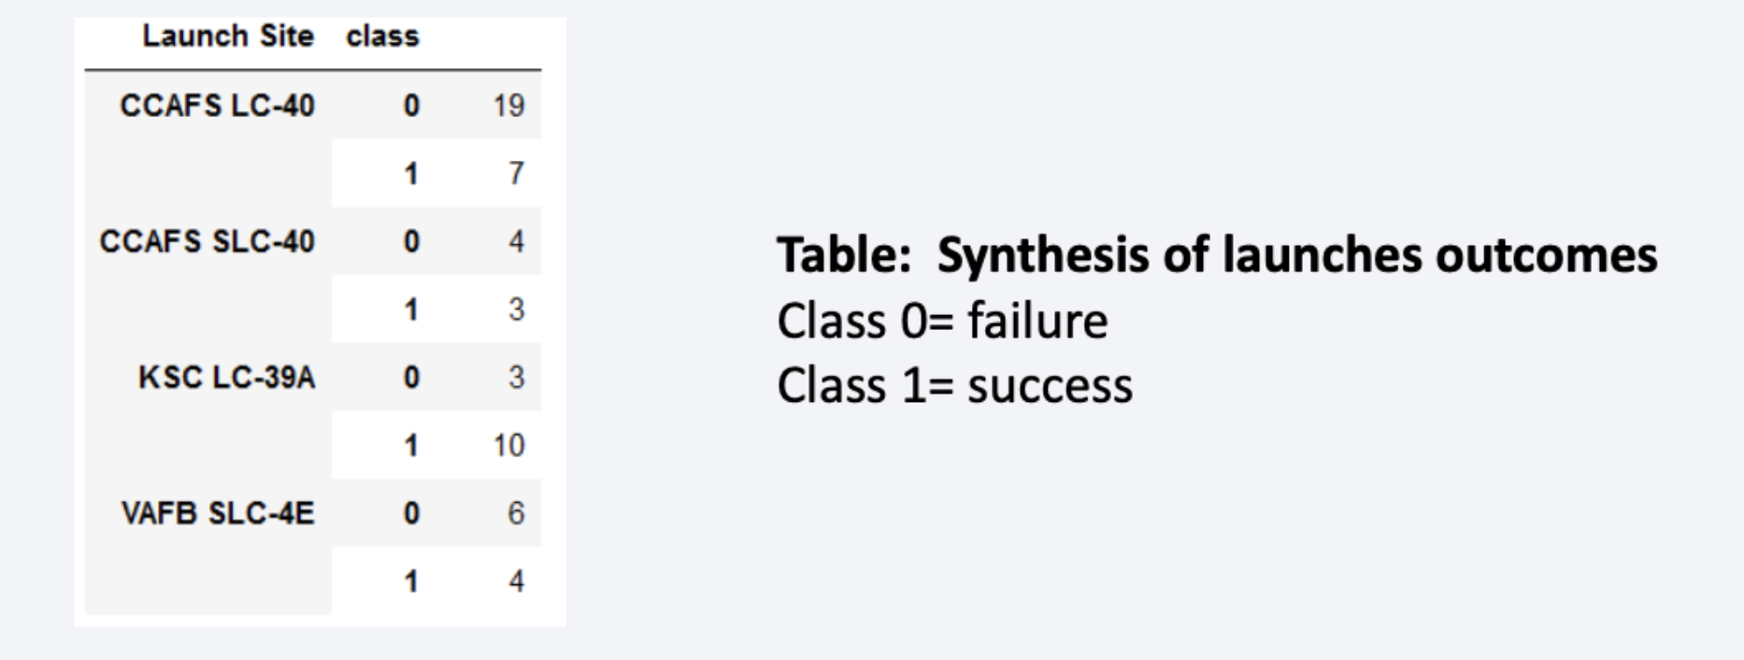
Interactive map with Folium Mark the success/failed launches for each site on the map

Slide 31
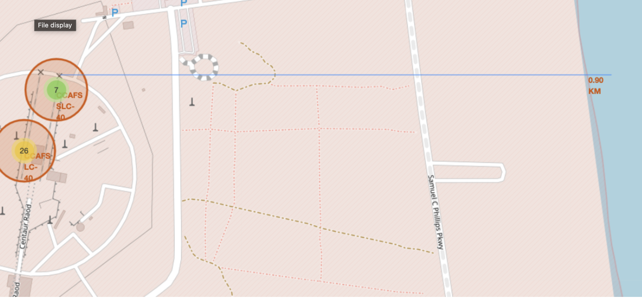
Interactive map with Folium Calculate the distances between a launch site to its proximities
This plot visually represents the distance between the CCAFS SLC-40 launch site and the nearest coastline. The calculated distance is approximately 0.51 kilometers, as indicated by the marker. The added PolyLine illustrates the straight-line distance, emphasizing the close proximity of the launch site to the coast. Such coastal positioning is typical for launch sites, as it supports over-water flight trajectories and safe booster recovery operations while minimizing risk to populated areas.

Slide 32
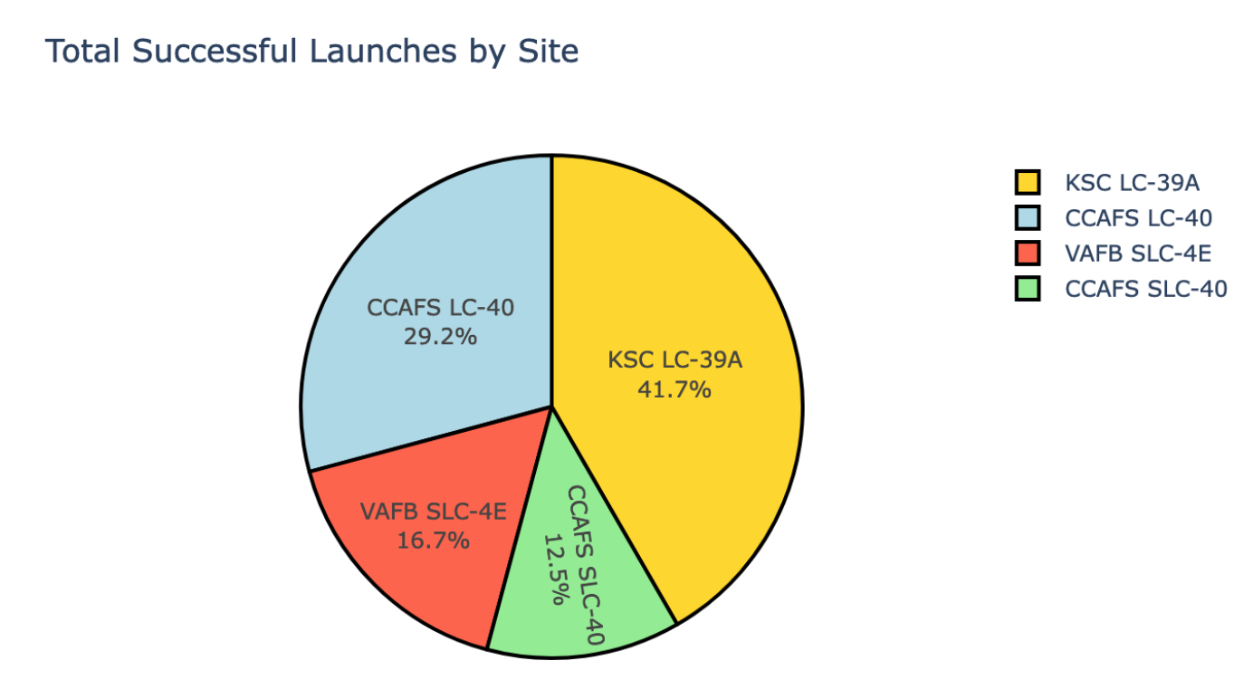
Build a Dashboard with Plotly Dash Launch success count for all sites
KSC LC-39A experienced the highest proportion of successful landings, followed by CCAFS LC-40.
VAFB SLC-4E and CCAFS SLC-40 the lowest.

Slide 33
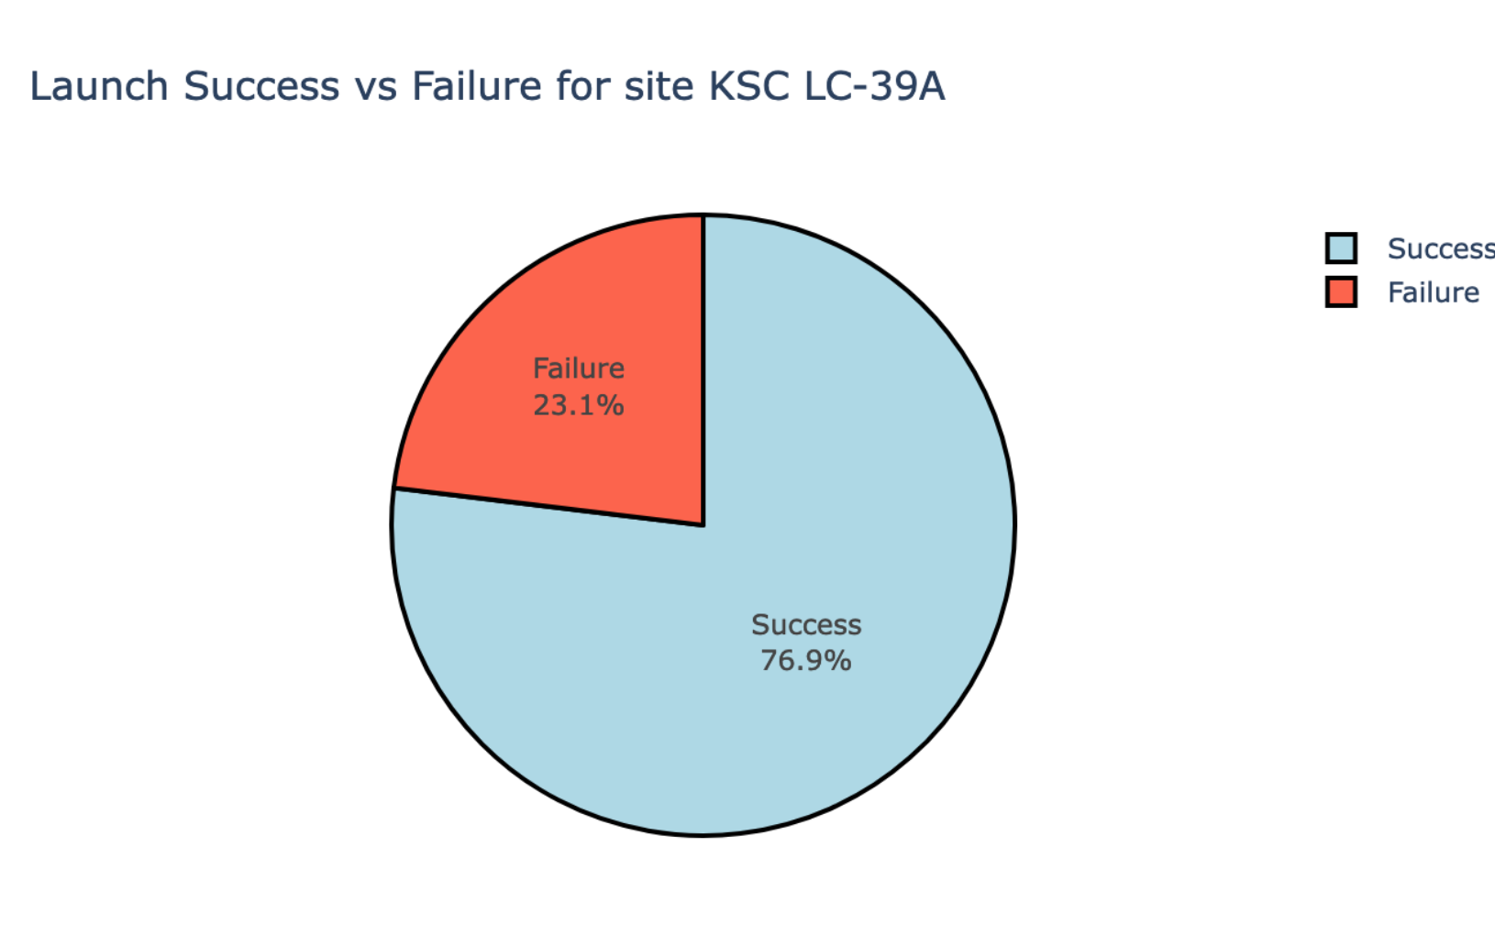
Build a Dashboard with Plotly Dash Launch site with highest launch success ratio

Slide 34
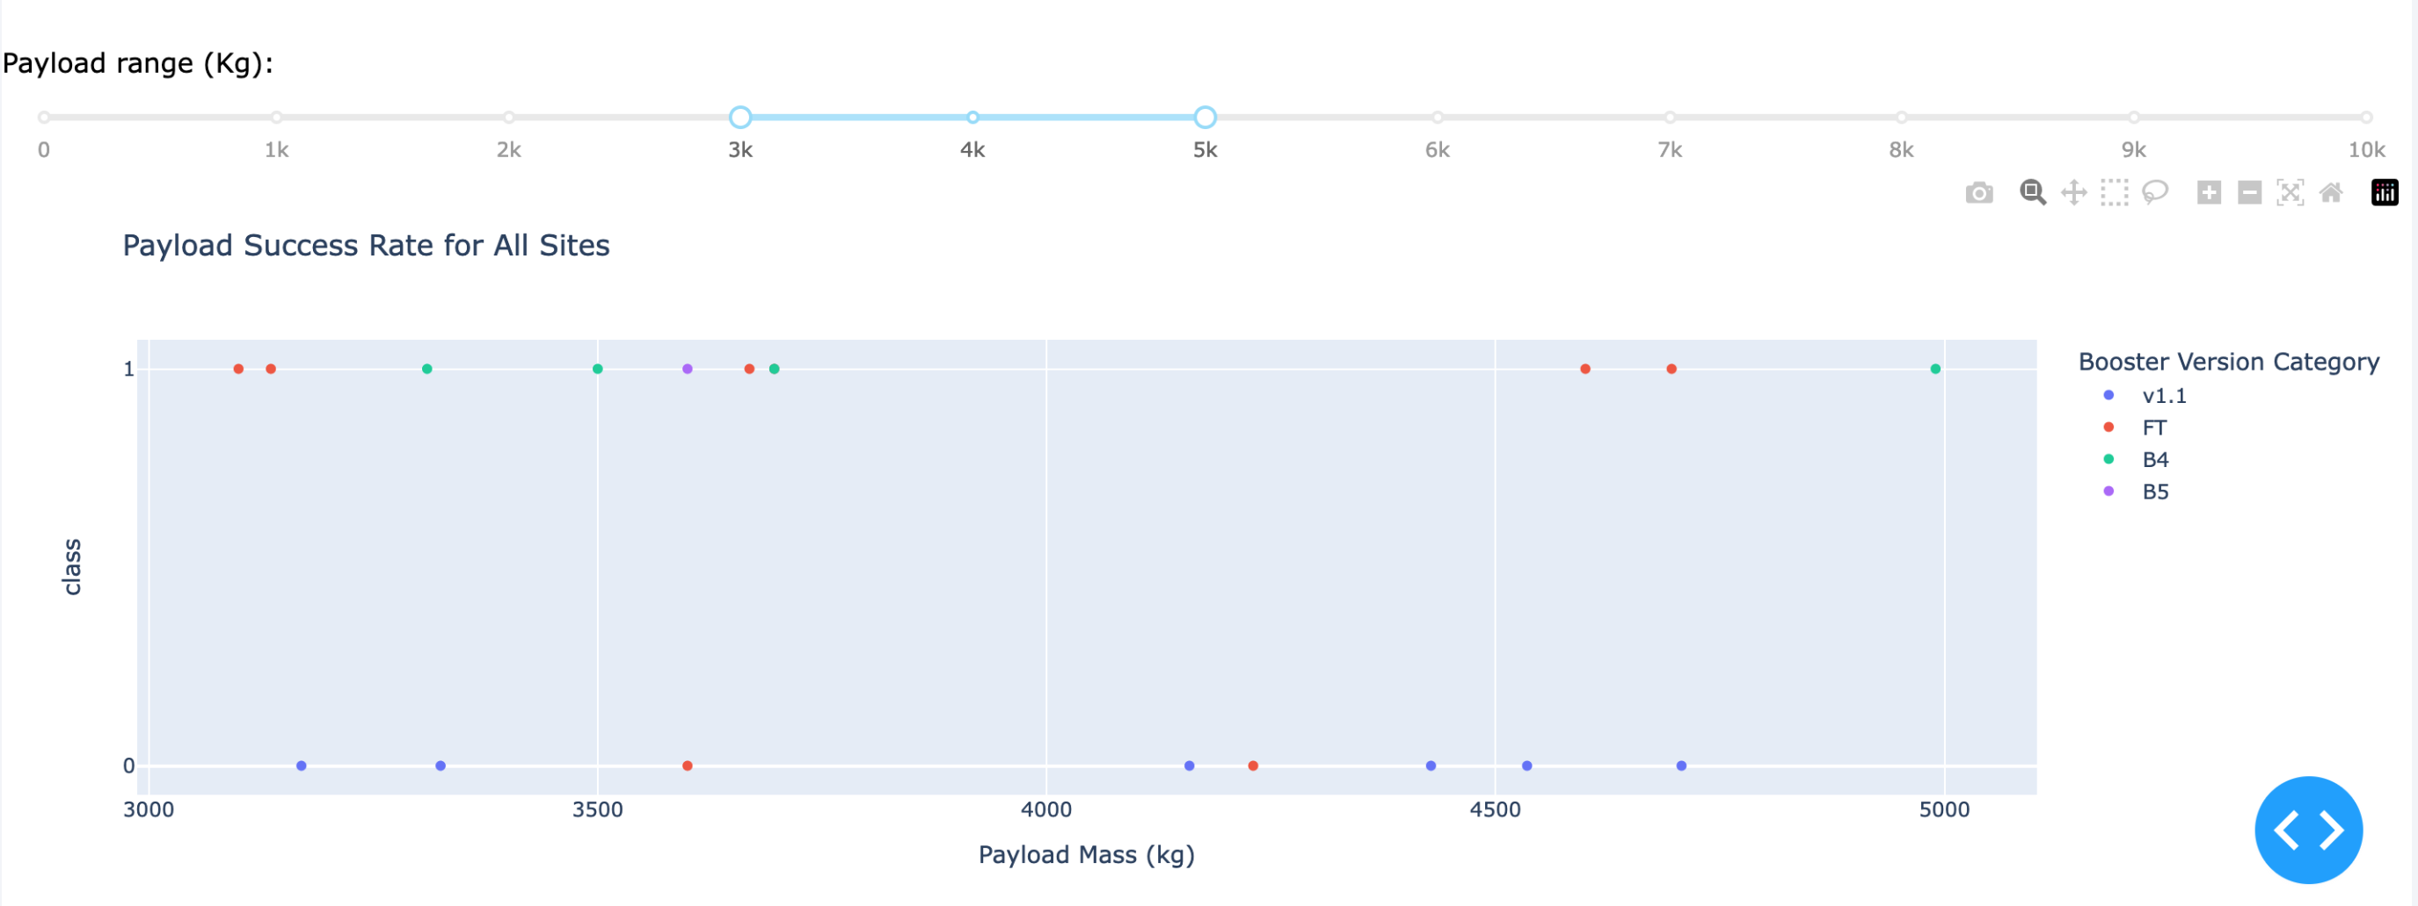
Build a Dashboard with Plotly Dash Payload
V1.0 and v1.1 are early launchers with low reliability.
Landing legs, were pioneered on the Falcon 9 v1.1 version, but that version never landed intact.
They were phased out in 2015.
FT: “Full Thrust” is the next generation and has the highest success rate for payload mass under 6 tons. Including with
“drone landing” (see details in next slide).
Many FT flights are done with reused launchers. And show good reliability.
Heavy payload are “high risk”.

Slide 35
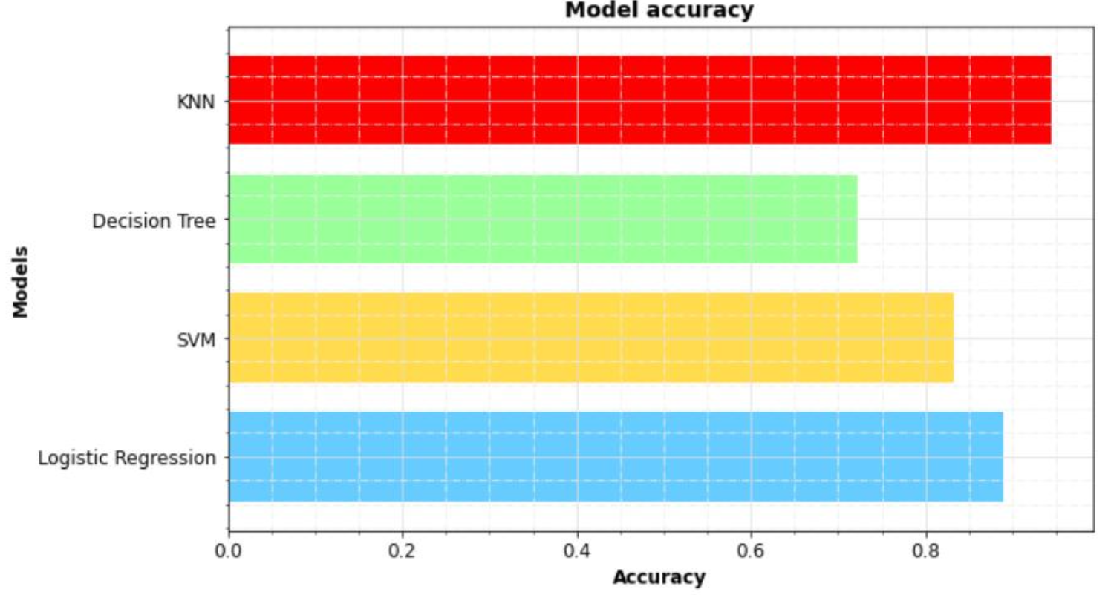
Classification Accuracy

Slide 36
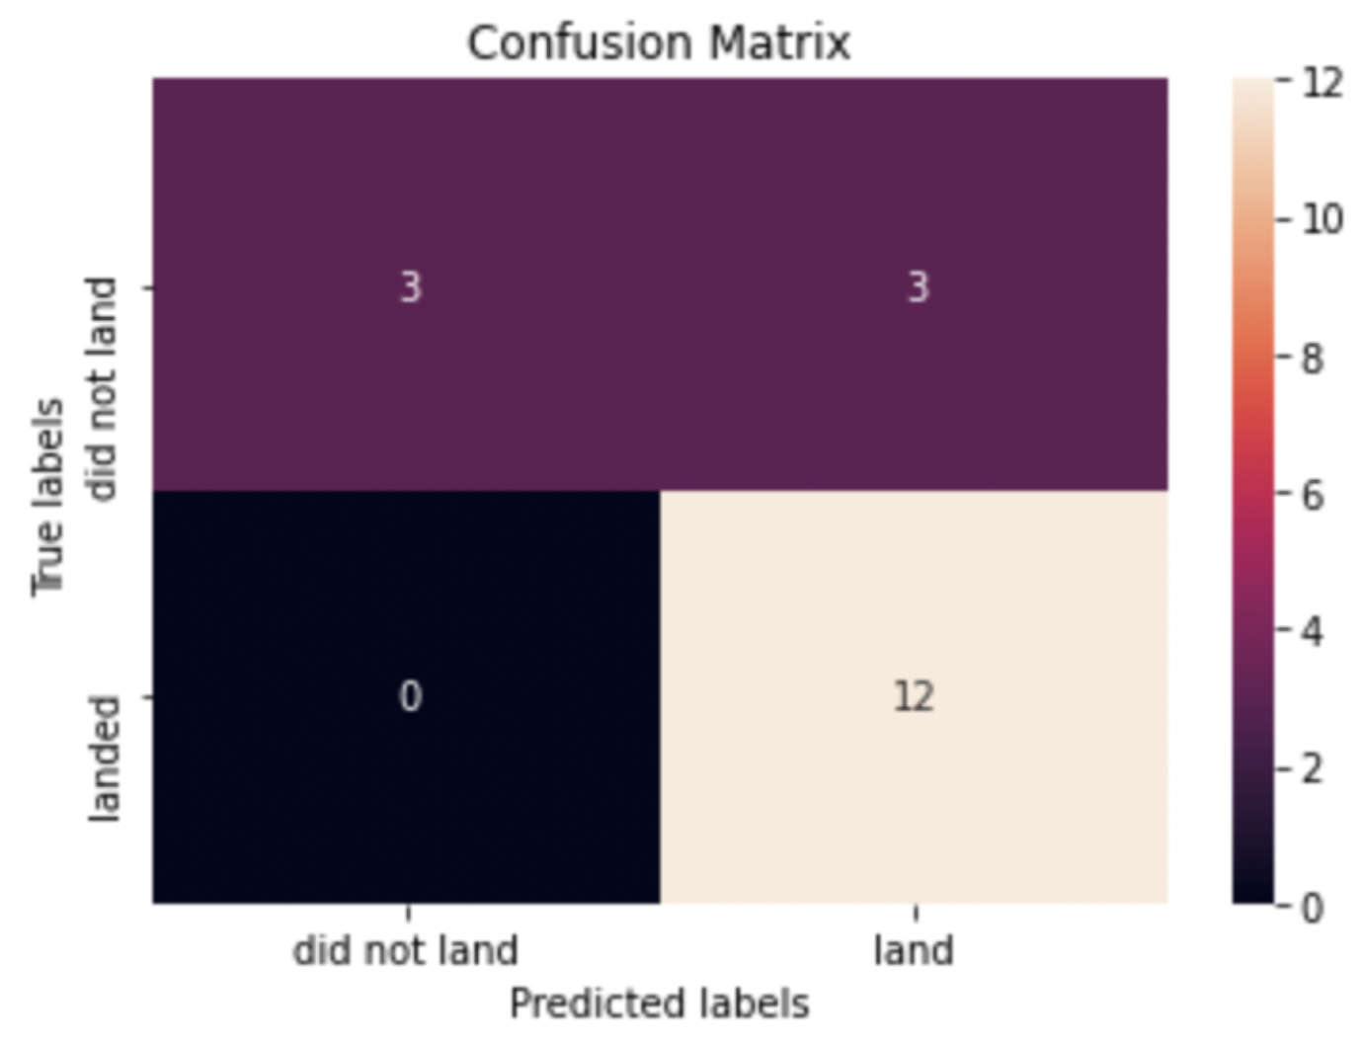
Confusion Matrix

Slide 37
Conclusion
Landing success rates show a clear upward trend over time across all analyzed factors, indicating continuous operational improvements and technological advancements. Analysis by orbit type reveals that certain orbits—such as ES-L1, SSO, HEO, and GEO—consistently achieve higher landing success rates. Launch site also emerged as a strong predictive factor, with KSC LC-39A demonstrating the highest performance, followed closely by CCAFS LC-40. Among the machine learning models evaluated, several achieved acceptable predictive performance; however, the Decision Tree Classifier delivered the best overall results, exhibiting high accuracy, precision, and recall in predicting landing outcomes.

